Slide 1
PHYS4260 Quantum Mechanics II Spring 2025
Time Dependent Perturbation Theory

Slide 2
Outline
Incoherent perturbations
Spontaneous emission
Einstein’s coefficients
Lifetime of an excited state
Final remarks on perturbation theory

Slide 3
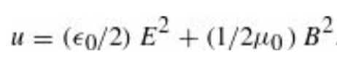
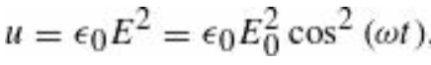
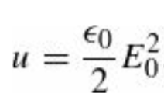
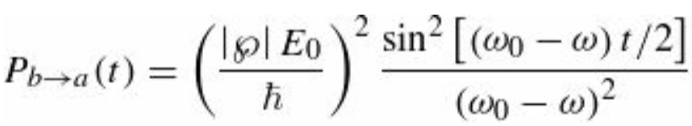
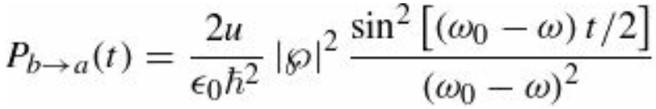
Re: Incoherent Perturbations
The energy per unit volume in electromagnetic fields is
For electromagnetic waves, the electric and magnetic contributions are equal, so
and the average over a full cycle is $ε_{0}E_{0}^{2}/2$ (remember that the average of ${(sin{ωt})}^{2}$or ${(cos{ωt})}^{2}$ is 1/2). Then, the energy density in an electromagnetic wave is
where $E_{0}$ is the amplitude of the electric field. So, the transition probability is (not surprisingly) proportional to the energy density of the fields:

Slide 4
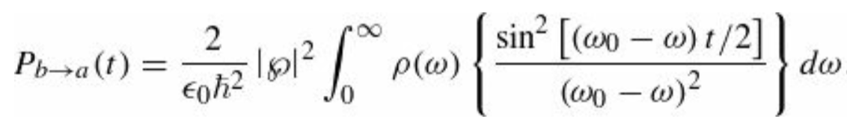
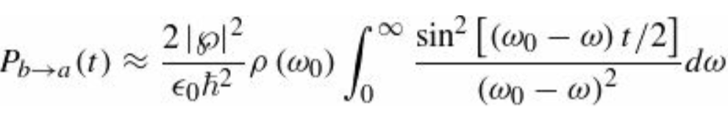
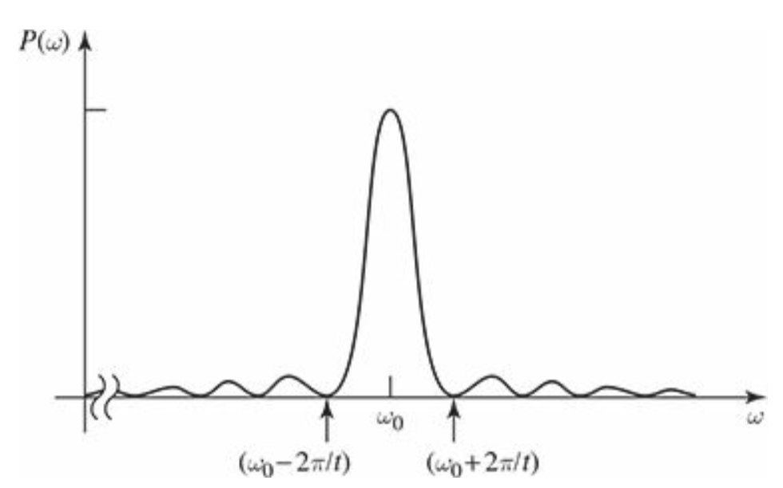
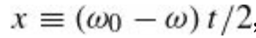
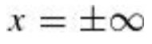
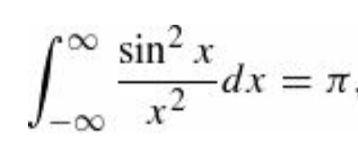
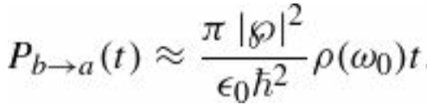
Re: Incoherent Perturbations
But the previous formula accounts for a monochromatic wave only, at a single frequency ω. In many applications the system is exposed to electromagnetic waves at a whole range of frequencies; in that case $u=ρ\left(ω\right)dω$ where $ρ\left(ω\right)dω$ is the energy density in the frequency range $dω$ and the net transition probability takes the form of an integral
The term in curly brackets is sharply peaked about $ω_{0}$ while $ρ\left(ω\right)$ is usually quite broad. We can replace it with $ρ(ω_{0})$ to simplify the integral in fact, this is a constant term now and can be brought out of the integration sign
We can perform the change of variable
and extend the integral to
as the integrand is essentially zero out there anyway), and looking up the definite integral
as we have found before. We find that

Slide 5
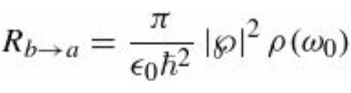
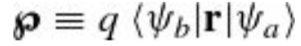
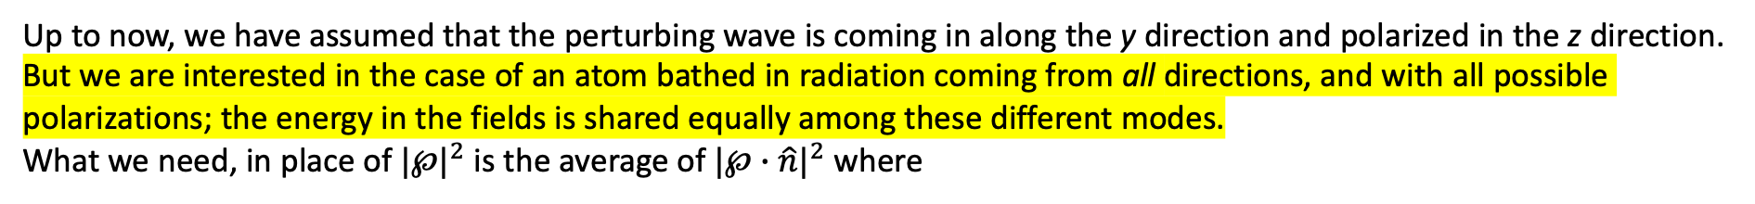
Re: Incoherent Perturbations
This time the transition probability is proportional to t. The bizarre “flopping” phenomenon characteristic of a monochromatic perturbation gets “washed out” when we hit the system with an incoherent spread of frequencies. In particular, the transition rate $R≡dP/dt$
Up to now, we have assumed that the perturbing wave is coming in along the y direction and polarized in the z direction. But we are interested in the case of an atom bathed in radiation coming from all directions, and with all possible polarizations; the energy in the fields is shared equally among these different modes.
What we need, in place of ${|℘|}^{2}$ is the average of ${|℘∙\hat{n}|}^{2}$ where
which generalizes our previous findings
and the average is over all polarizations and all incident directions.

Slide 6
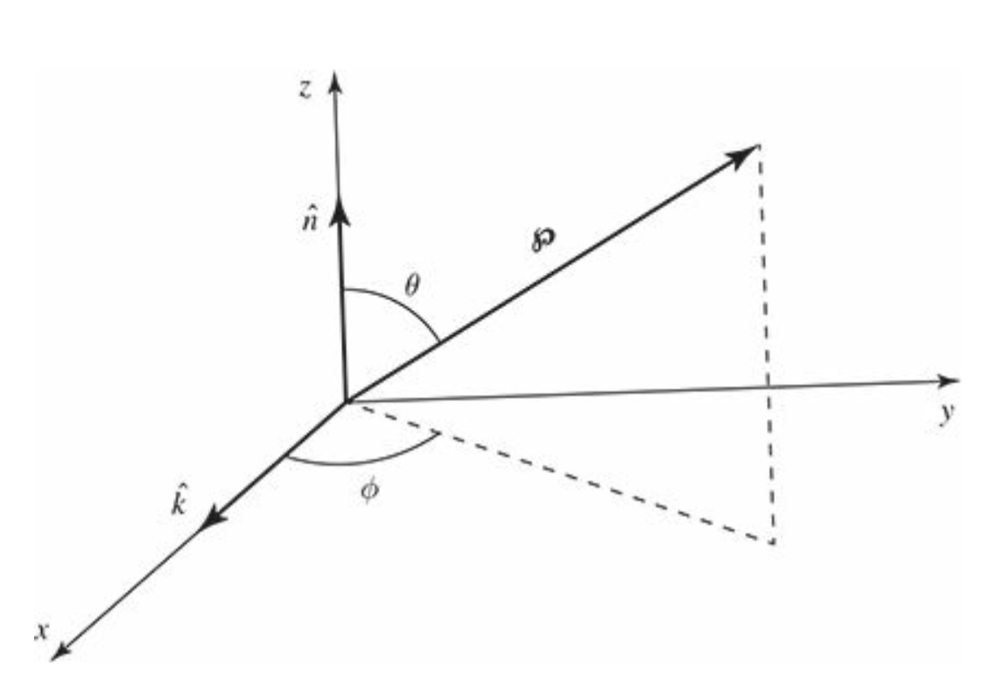
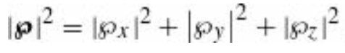
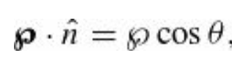
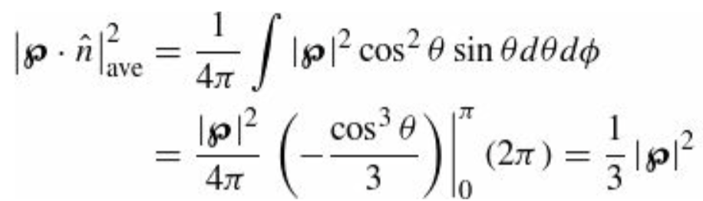
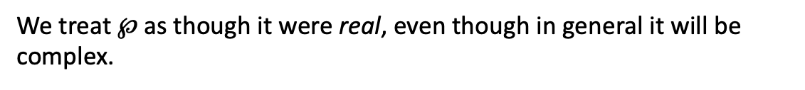
Incoherent Perturbations
The averaging can be carried out as follows: Choose spherical coordinates such that the direction of propagation $\hat{k}$ is along $x$, and the polarization $\hat{n}$ is along $z$, and the vector $℘$ defines the spherical angles θ and φ
We treat $℘$as though it were real, even though in general it will be complex.
We can do the whole calculation for the real and imaginary parts separately and simply add the results. The absolute value signs denote both the vector magnitude and the complex amplitude:
$℘$is fixed, here, and we’re averaging over all $\hat{k}$ and $\hat{n}$ consistent with $\hat{k}⊥\hat{n}$ which means over all θ and φ.
Equivalently, we might as well integrate over all directions of $℘$ by keeping $\hat{k}$ and $\hat{n}$ fixed. Then we have

Slide 7
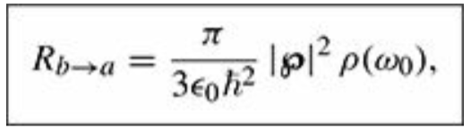
Incoherent Perturbations
The transition rate for stimulated emission from state b to state a, under the influence of incoherent, unpolarized light incident from all directions, is
where $℘$is the matrix element of the electric dipole moment between the two states $ψ_{a}$ and $ψ_{b}$ and $ρ(ω_{0})$ is the energy density in the fields, per unit frequency, evaluated at $ω_{0}={(E}_{b}−$ $E_{a})/ℏ$

Slide 8
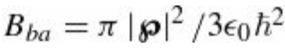
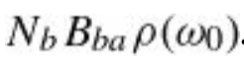
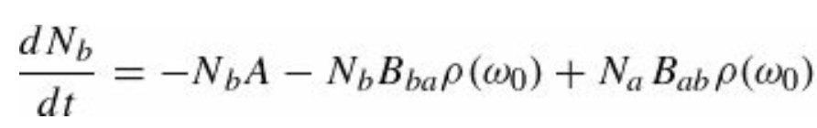
Spontaneous Emission: Einstein’s A and B Coefficients
Let’s assume we have an atom container with $N_{a}$ atoms in the lower state $ψ_{a}$, and $N_{b}$ atoms in the upper state $ψ_{b}$.
Let $A$ (Einstein notation) be the spontaneous emission rate so that the number of particles leaving the upper state by this
process, per unit time, is $N_{b}A$.
We assume that $N_{a}$and $N_{b}$are very large, so we can treat them as continuous functions of time and ignore
statistical fluctuations.
The transition rate for stimulated emission, is proportional to the energy density of the electromagnetic field: $B_{ba}ρ(ω_{0})$
where:
The number of particles leaving the upper state by this mechanism, per unit time, is
The absorption rate is likewise proportional to $ρ\left(ω_{0}\right);$ we can call it $B_{ab}ρ\left(ω_{0}\right).$
The number of particles per unit time joining the upper level is therefore ${N_{a}B}_{ab}ρ(ω_{0})$.
Therefore,

Slide 9
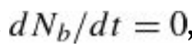
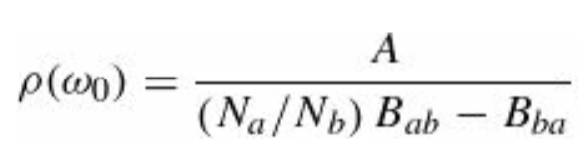
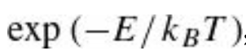
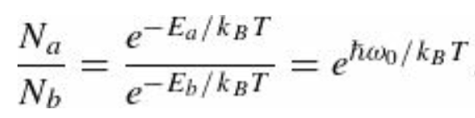
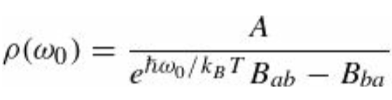
Spontaneous Emission: Einstein’s A and B Coefficients
Suppose these atoms are in thermal equilibrium with the ambient field, so that the number of particles in each level is constant. In that case
And we have that
On the other hand, we know from statistical mechanics that the number of particles with energy E, in thermal equilibrium at temperature T, is proportional to the Boltzmann factor,
Which means that
and substituting into the $ρ$ formula above, we get
This should look familiar now!

Slide 10
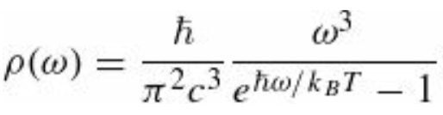
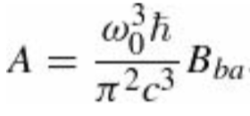
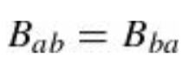
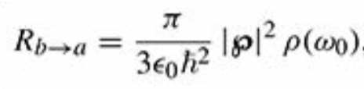
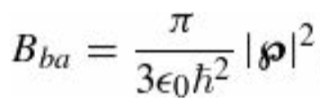
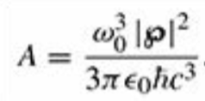
Spontaneous Emission: Einstein’s A and B Coefficients
In fact, from Planck’s blackbody radiation formula, which tells us the energy density of thermal radiation we have:
and comparing the two expressions, we conclude that
and
This equation confirms what we already knew: the transition rate for stimulated emission is the same as for absorption.
But it was an astonishing result in 1917—indeed, Einstein was forced to “invent” stimulated emission in order to reproduce Planck’s formula.
Our present attention, however, focuses on the equation for $A$. This tells us the spontaneous emission rate in terms of the stimulated emission rate $B_{ba}ρ(ω_{0})$
From
we read off
and it follows that the spontaneous
emission rate is

Slide 11
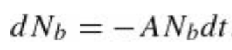
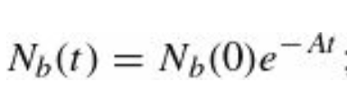
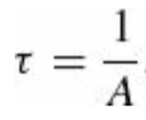
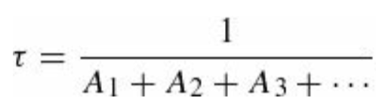
The Lifetime of an Excited State
The equation for the coefficient $A$ which we have just found is our fundamental result; it gives the transition rate for spontaneous emission.
Suppose, now, that you have somehow pumped a large number of atoms into the excited state. As a result of spontaneous emission, this number will decrease as time goes on; specifically, in a time interval $dt$ you will lose a fraction $Adt$ of them
assuming there is no mechanism to replenish the supply. Solving for $N_{b}(t)$
Evidently the number remaining in the excited state decreases exponentially, with a time constant
We call this the lifetime of the state—technically, it is the time it takes for $N_{b}(t)$ to reach $1/e≈$0.368 of its value.
We have assumed all along that there are only two states for the system, but this was just for notational simplicity—
the spontaneous emission formula $A$ gives the transition rate for $ψ_{b}→ψ_{a}$ regardless of what other states may be accessible
Typically, an excited atom has many different decay modes (that is: $ψ_{b}$ can decay to a large number of different
lower-energy states, $ψ_{a1},ψ_{a2},ψ_{a3}$,… In that case the transition rates add, and the net lifetime is

Slide 12
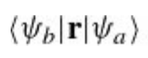
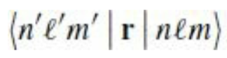
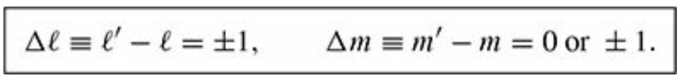
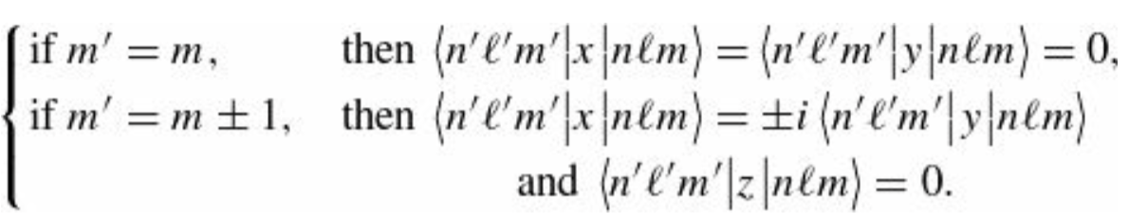
Selection rules
The calculation of spontaneous emission rates has been reduced to a matter of evaluating matrix elements of the form
These quantities are very often zero, and it would be helpful to know in advance when this is going to happen, so we don’t waste a lot of time evaluating unnecessary integrals. Suppose we are interested in systems like hydrogen, for which the Hamiltonian is spherically symmetrical. In that case we can specify the states with the usual quantum numbers $n, l, m$ and the matrix elements are
$r$ is a vector operator, and we can invoke the results we previously learned to obtain the selection rules
These conditions follow from symmetry alone. If they are not met, then the matrix element is zero, and the transition is said to be forbidden. Moreover, it follows from equations

Slide 13
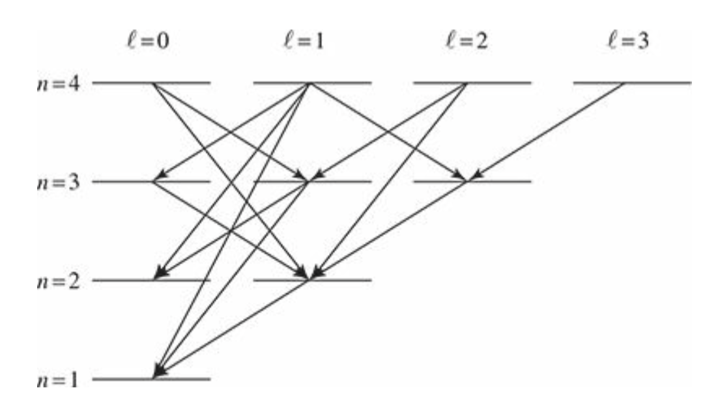
Selection rules
So, it is never necessary to compute the matrix elements of both x and y; you can always get one from the other.
Evidently not all transitions to lower-energy states can proceed by electric dipole radiation; most are forbidden by the selection rules. The scheme of allowed transitions for the first four Bohr levels in hydrogen is shown in the Fig. below.
Notice that the 2S state $ψ_{200}$ is “stuck”: it cannot decay, because there
is no lower- energy state with $l=1$. It is called a metastable state, and
its lifetime is indeed much longer than that of, for example, the 2P states
$ψ_{210},ψ_{211},ψ_{21−1}$. Metastable states do eventually decay, by collisions,
or by “forbidden” transitions, or by multiphoton emission.
Fig.: Allowed decays for the first four Bohr levels in hydrogen

Slide 14
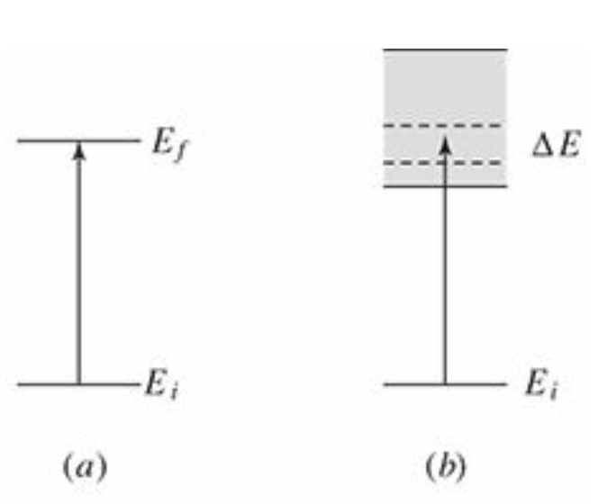
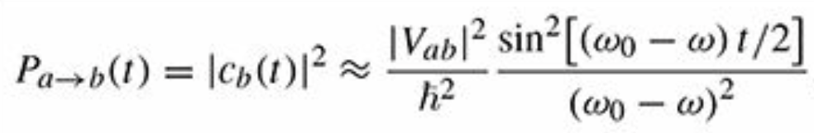
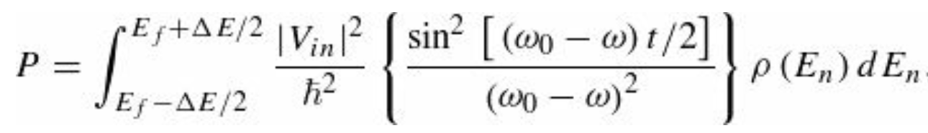
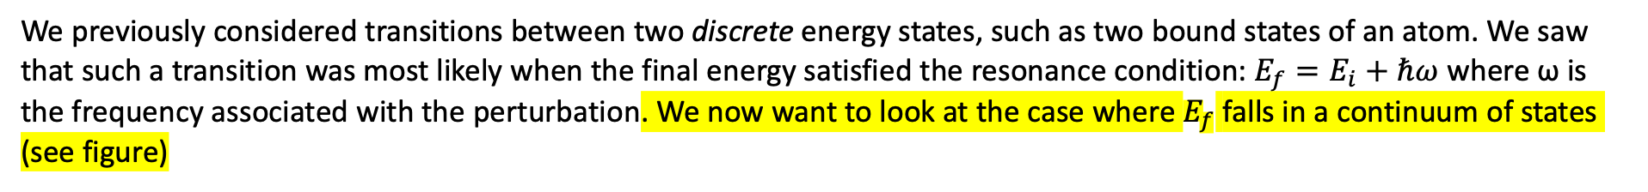
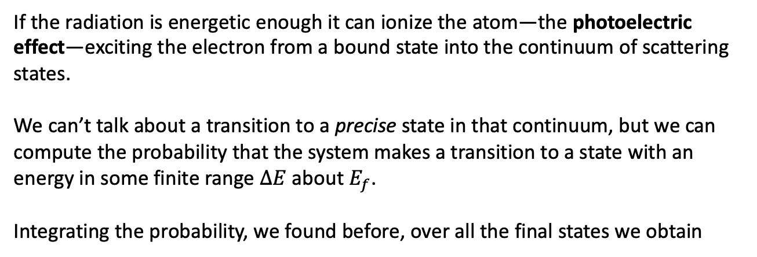
Fermi’s Golden Rule (continuum of states)
We previously considered transitions between two discrete energy states, such as two bound states of an atom. We saw that such a transition was most likely when the final energy satisfied the resonance condition: $E_{f}=E_{i}+ℏω$ where ω is the frequency associated with the perturbation. We now want to look at the case where $E_{f}$ falls in a continuum of states (see figure)
If the radiation is energetic enough it can ionize the atom—the photoelectric effect—exciting the electron from a bound state into the continuum of scattering states.
We can’t talk about a transition to a precise state in that continuum, but we can compute the probability that the system makes a transition to a state with an energy in some finite range $ΔE$ about $E_{f}$.
Integrating the probability, we found before, over all the final states we obtain
Here we have that $ω_{0}=(E_{n}−E_{i})/$ $ℏ$ and $ρ\left(E\right)dE$ represents the number of states with energy between
$E$ and $E+dE$. $ρ\left(E\right)$ is called the density of states.

Slide 15
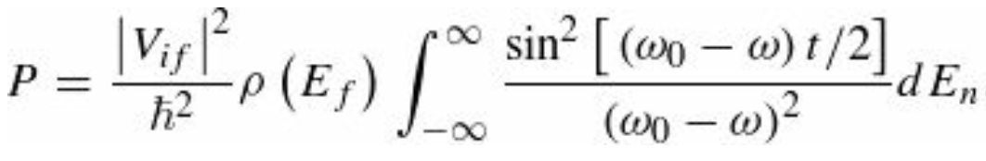



Fermi’s Golden Rule
At short times, the formula leads to a transition probability proportional to $t^{2}.$ In fact,
at short times
The same happens for a transition between discrete states. On the other hand, at long times the quantity in curly brackets is sharply peaked: as a function of $E_{n}$ its maximum occurs at $E_{f}=E_{i}+ℏω$ and the central peak has a width of $4πℏ/t$.
For sufficiently large t, we can again approximate the integral as
The remaining integral was previously evaluated

Slide 16




Fermi’s Golden Rule
The oscillatory behavior of P has again been “washed out,” giving a constant transition rate
Notice that in deriving equation
our perturbation was
since we dropped the other (off-resonance) exponential. That is the source of the two inside the absolute value in equation above. The expression for $R$ is the Fermi’s Golden Rule that we have seen before. It seems that also P.A.M. Dirac came up with the same result independently, but E. Fermi is the one who gave it the memorable name.
It is instructive at this point to look at Example 11.2

Slide 17



Ex 11.2: Differential scattering cross-section
Use Fermi’s Golden Rule to obtain the differential scattering cross-section for a particle of mass m and incident wave
vector $k′$ scattering from a potential $V(r)$
We take our initial and final states to be plane waves:
Here we used a technique called box normalization; we place the whole setup inside a box of length $l$on a side. This makes the free-particle states normalizable and countable. Formally, we want the limit $l→∞$, in practice $l$ will drop out of our final expression. Using periodic boundary conditions, the allowed values of $k$ are
$n_{x}$, $n_{y}$, $n_{z}$ are integers

Slide 18





Ex 11.2: Differential scattering cross-section
Our perturbation is the scattering potential ${\hat{H}}^{′}=V(r)$ and the relevant matrix element is
We need to determine the density of states. In a scattering experiment we measure the number of particles scattered into a solid angle $dΩ$. We want to count the number of states with energies between $E$ and $E+dE$ with wave vectors
$k$ lying inside $dΩ$. In the k space, these states occupy a section of a spherical shell of radius k and thickness $dk$ that subtends a solid angle; it has a volume
and contains a number of states

Slide 19







Ex 11.2: Differential scattering cross-section
From Fermi’s Golden Rule, the rate at which particles are scattered into the solid angle
This is closely related to the differential scattering cross section:
Where $J_{i}$ is the flux (or probability current) of incident particles. For an incident wave of the form
(remember that $p=ℏk$ and A is the normalization,
and that
And we obtain
This is exactly the result obtained from the first Born approximation.

Slide 20










Final remarks on Perturbation Series
In the generic case of a time-dependent Hamiltonian for which an analytical solution is unavailable we must turn to a perturbative analysis, looking for an expansion of the basis coeﬃcients $c_{n}(t)$ in powers of the interaction,
where $c_{n}^{(m)}$ ∼$O(V^{m})$ and $c_{n}^{(0)}$ is some (time-independent) initial state. The task to complete this series expansion is straightforward but technical.
In the interaction representation* we have where the state at time $t$ is related to an initial state at time $t_{0}$ through a time-evolution operator. In fact, we observe that the state
Satisfies the equation of motion
where
and
*Note that in the Heisenberg representation we have

Slide 21





Final remarks on Perturbation Series
Therefore, we can write
with the boundary condition
. Integrating this equation from $t_{0}$ to $t$, formally we obtain,
This result provides a self-consistent equation for $U_{I}\left(t,t_{0}\right),$ i.e. if we take this expression and substitute $U_{I}(t^{′},t_{0})$ under the integrand, we obtain
Iterating this procedure, we thus obtain
(1)

Slide 22




Final remarks on Perturbation Series
The term $n = 0$translates to $𝕀$. Note that the operators $V_{I} (t)$ are organized in a time-ordered sequence, with
$t_{0}≤t_{n}≤t_{n−1}≤$… $≤t_{1}≤t$. With this understanding, we can write this expression more compactly as
where “T” denotes the time-ordering operator, and its action is understood by Eq. (1). If a system is prepared in an initial state, $|i⟩$ at time ${t=t}_{0}$, at a subsequent time, $t$, the system will be in a final state,
Making use of Eq. (1), and the resolution of identity, $\sum_{m}{|m⟩⟨m|}=𝕀$, we obtain

Slide 23




Final remarks on Perturbation Series
Re calling that
we thus find the coefficients perturbatively
where
and
The probability of eﬀecting a transition from state $|i⟩$ to state $|n⟩$ for $n≠i$ is given

Slide 24





The question (or quest?) for convergence
In 1952 Freeman Dyson shocked the high energy physics community by declaring that, quite generally, the QED perturbation series cannot converge. Suppose we have the form of a physical quantity given as a power series in the charge coupling in QED
for some nonzero value of $e^{2}$ , then $F(e^{2})$ is analytic at $e = 0$, this must mean that the physical quantity is an analytic function of $e$ for $e = 0$. Therefore, if it is an analytic function, we can extend $e^{2}$ to the complex plane and the radius of convergence must be finite about $e^{2}=0$. So,
should also be convergent for sufficiently small values of $e^{2}$. We can interpret the physical quantity $F({−e}^{2})$ as arising
in a world where like charges attract each other.

